Slide 1
Aurora
Paul mpanga
Nick larsen

Slide 2
Requirements
Cash Transfer App
Must be able to create an account with a password
Must be able to deposit money
Must be able to withdraw money
Must be able to transfer money to a different user’s account
Must be able to check balance
Must accurately record transactions
Must connect to an Excel spreadsheet or database to keep track of transactions

Slide 3
Tools/Services and languages
Tools/Services
Android Studio
Go Daddy
PHPMyAdmin
Languages
Java (including JSON)
PHP
MySQL

Slide 4
Analysis Artifacts

Slide 5
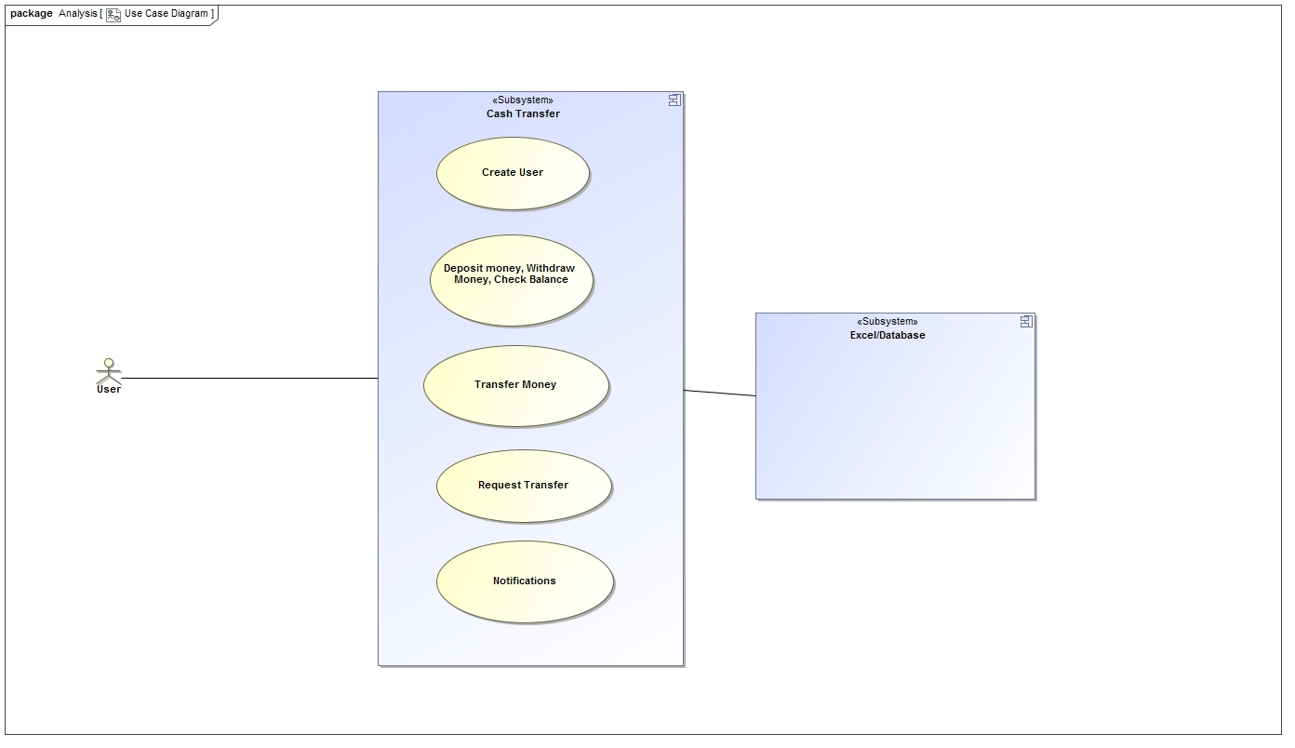
Use Case Diagram

Slide 6
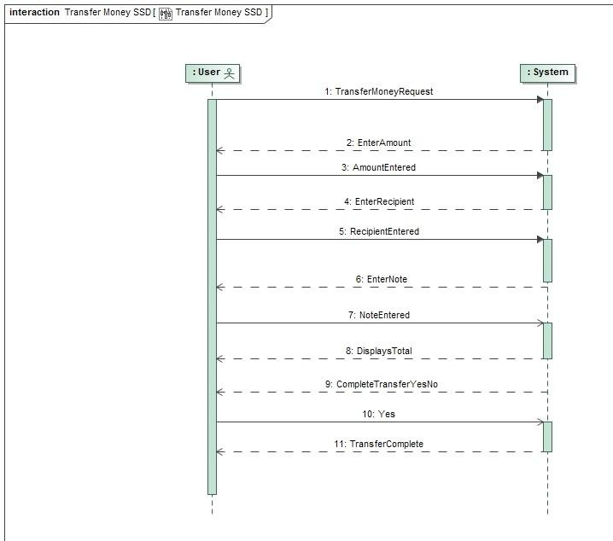
Transfer Money SSD

Slide 7
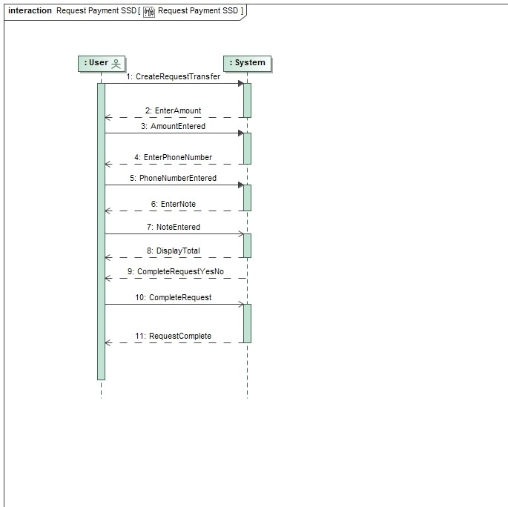
Request Payment SSD

Slide 8
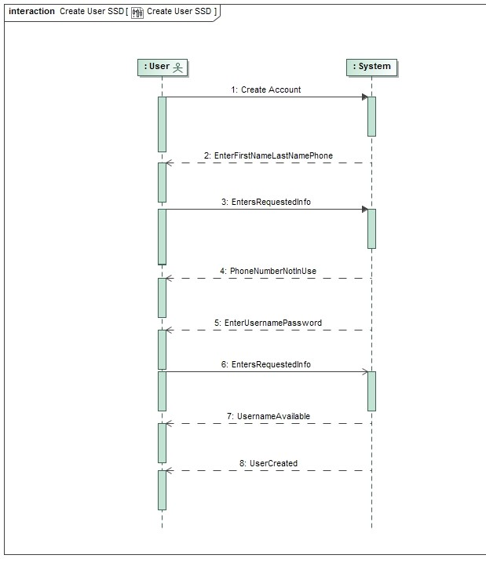
Create User SSD

Slide 9
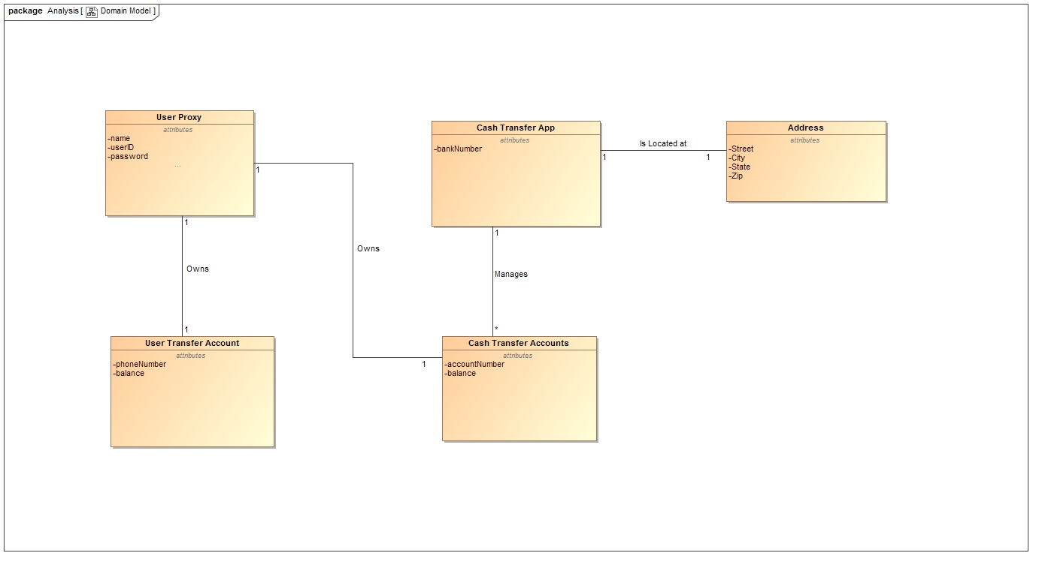
Domain Model

Slide 10
Design Artifacts

Slide 11
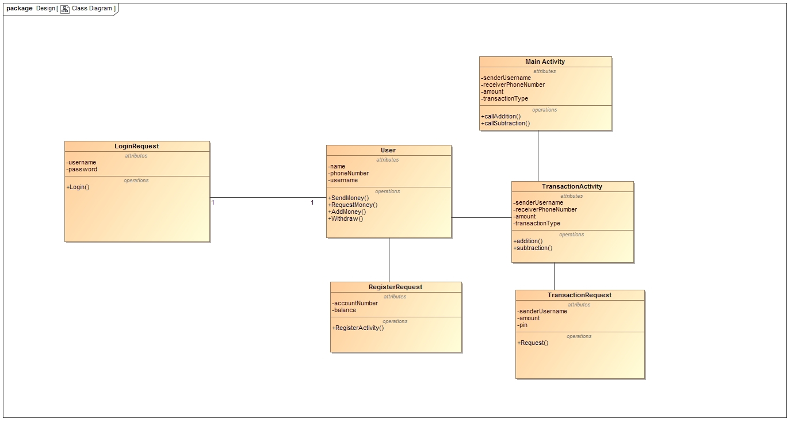
Original Class Diagram

Slide 12
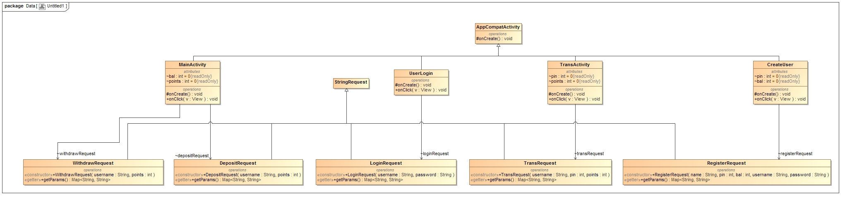
Final Class Diagram

Slide 13
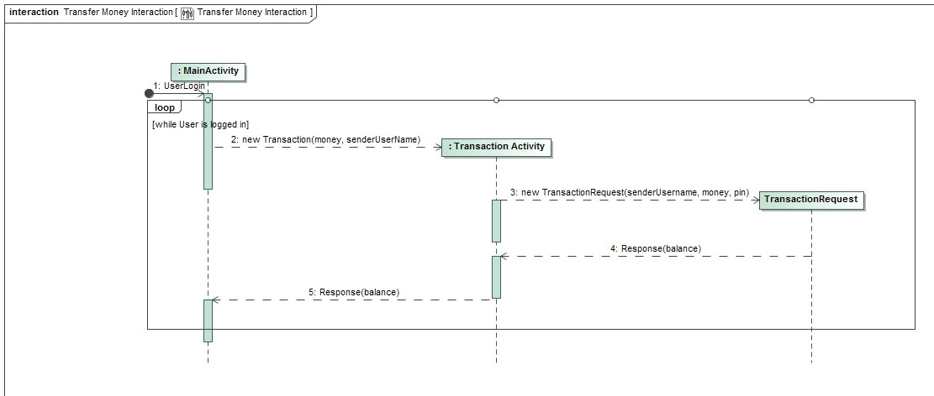
Transfer Money Interaction Diagram

Slide 14
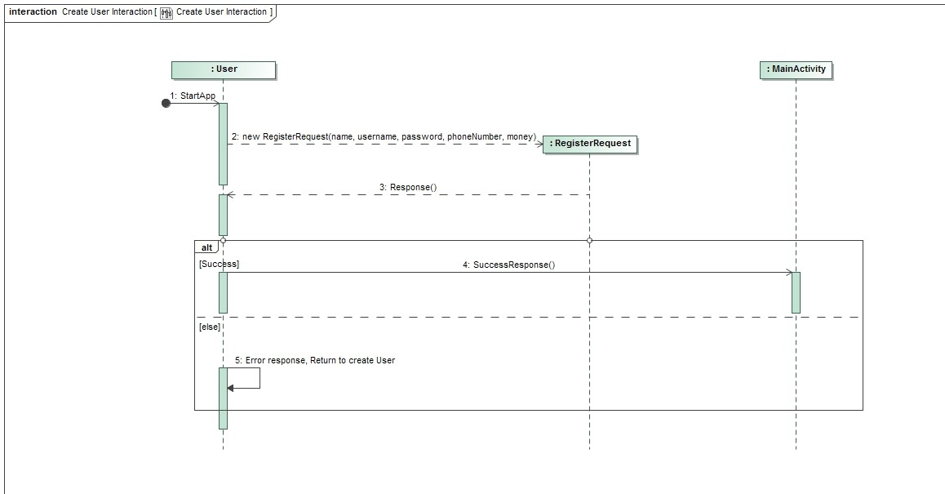
Create User Interaction Diagram

Slide 15
DEMO!

Slide 16
Team Organization
Paul – Developer
Nick – Project Manager
Just kidding!

Slide 17
Real Team Organization
Android Studio not compatible with Nick’s computer ☹
Paul was main developer
Nick was main “project manager”
We did both
Nick wrote WithdrawRequest and DepositRequest in Java, worked with Paul to convert

Slide 18
How team stayed in sync
Email
In person (class and outside)
Text
No GitHub

Slide 19
What would we do differently
Serialization or hibernate
Picked a better IDE
Card.IO API
Money not points
Created fake bank accounts
Start programming… later?

